Slide 1
A* Search
The most common informed search algorithm is A* search (pronounced “A-star search”), a best-first search that uses the evaluation function,
f(n) = g(n) +h(n)
where g(n) is the path cost from the initial state to node n, and h(n) is the estimated cost of the cheapest path from n to a goal state, so we have,
f(n) = estimated cost of the best path that continues from n to a goal.

Slide 2
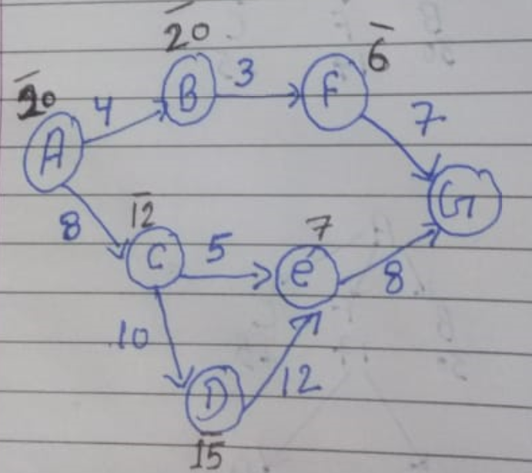
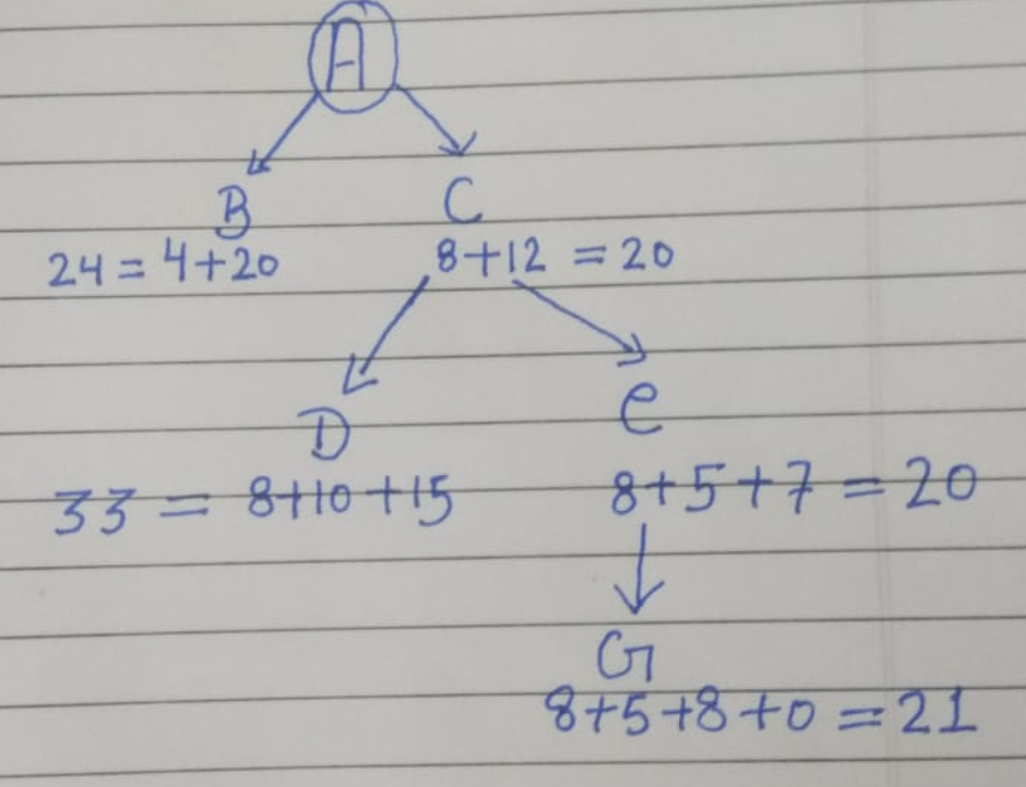
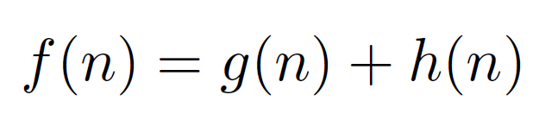
A* search

Slide 3
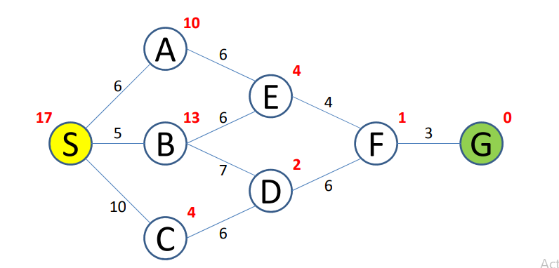

Slide 4
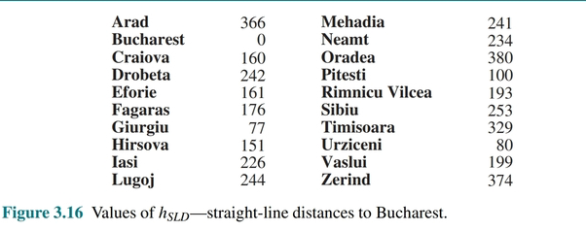

Slide 5
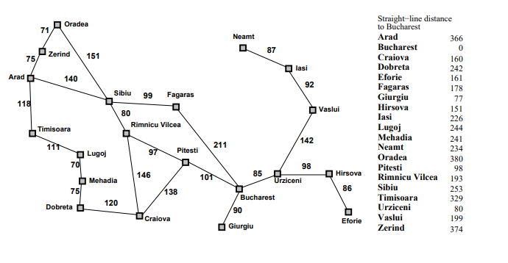

Slide 6
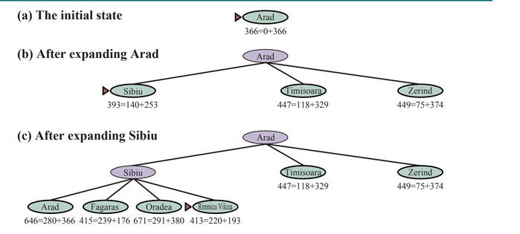

Slide 7
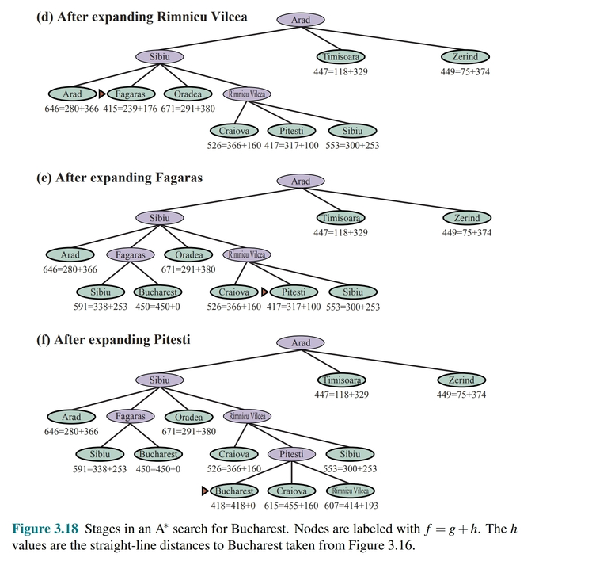

Slide 8
A* search : Admissibility
The condition we require for optimality is that h(n) be an admissible heuristic.
An admissible heuristic is one that never overestimates the cost to reach the goal.
Admissible heuristics are by nature optimistic because they think the cost of solving the problem is less than it actually is.
Straight-line distance is admissible because the shortest path between any two points is a straight line, so the straight line cannot be an overestimate.
h(n) <= h*(n) ------------Underestimation
h(n) > h*(n) ------------Overestimation

Slide 9
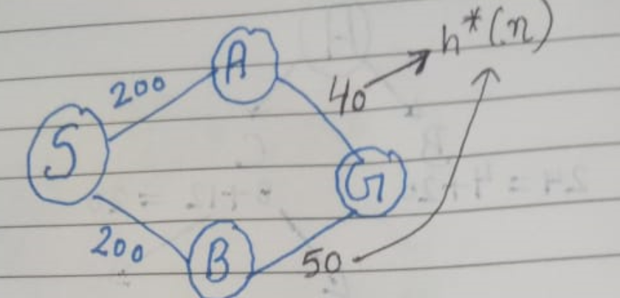
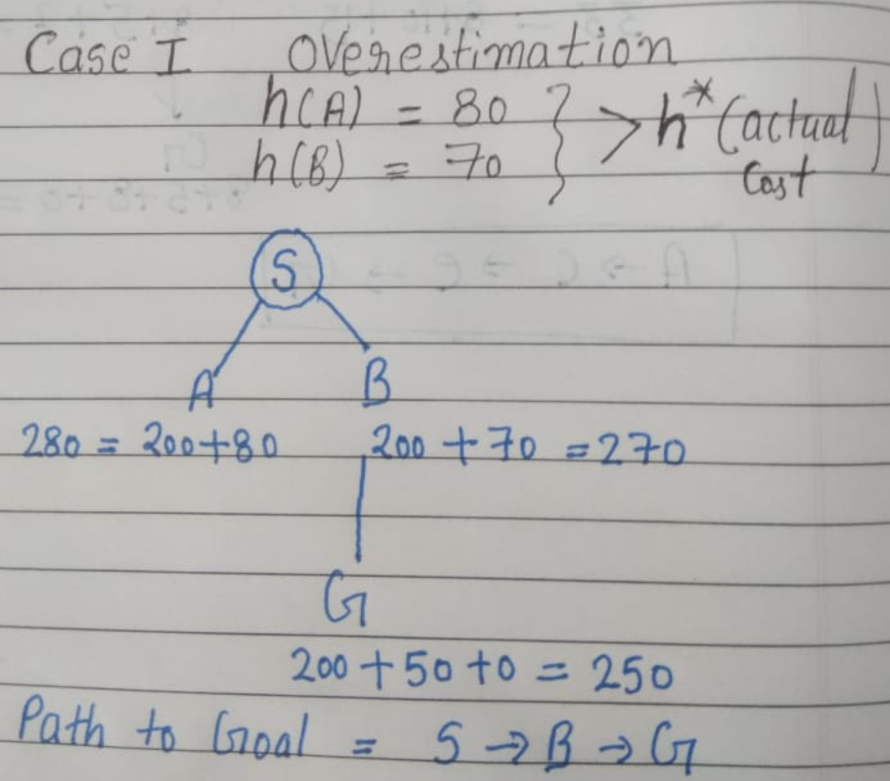
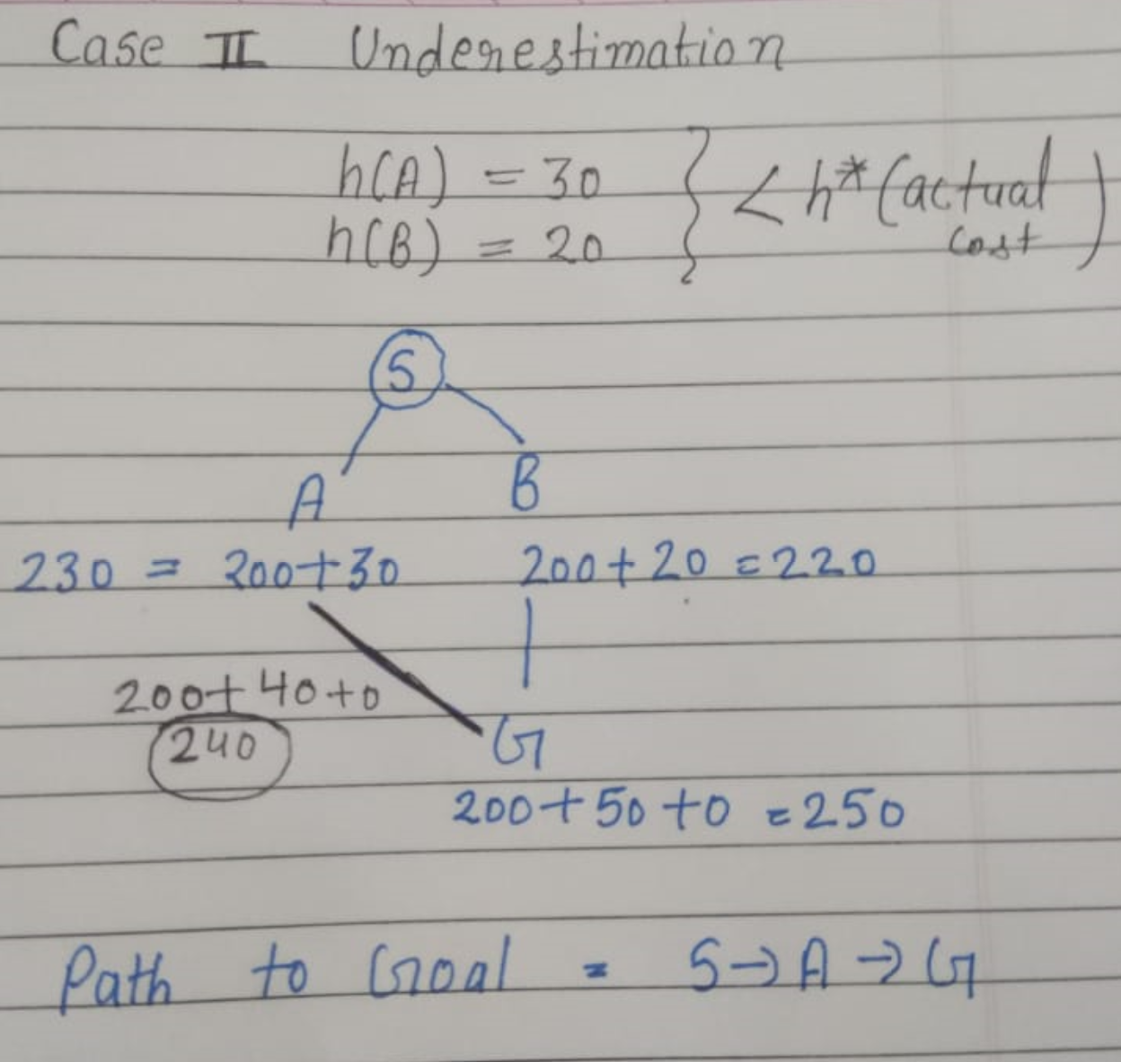
A* search : Admissibility

Slide 10
A* search is complete.!!
Whether A* is cost-optimal depends on certain properties of the heuristic.
A key property is admissibility an admissible heuristic is one that never overestimates the cost to reach a goal. (An admissible heuristic is therefore optimistic.)
With an admissible heuristic, A* is cost-optimal.
Suppose the optimal path has cost C*, but the algorithm returns a path with cost C > C*. Then there must be some node n which is on the optimal path and is unexpanded.

Slide 11
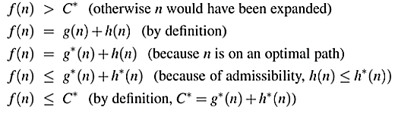
The notation g*(n) denote the cost of the optimal path from the start to n, and h*(n) denote the cost of the optimal path from n to the nearest goal, we have:
a suboptimal path must be wrong—it must be that A* returns only cost-optimal paths.

Slide 12
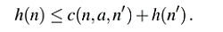
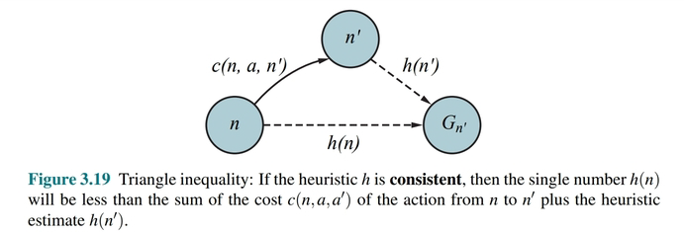
A heuristic h(n) is consistent if, for every node n and every successor n’ of n generated by an action a, we have:
This is a form of the triangle inequality, which stipulates that a side of a triangle cannot be longer than the sum of the other two sides.

Slide 13
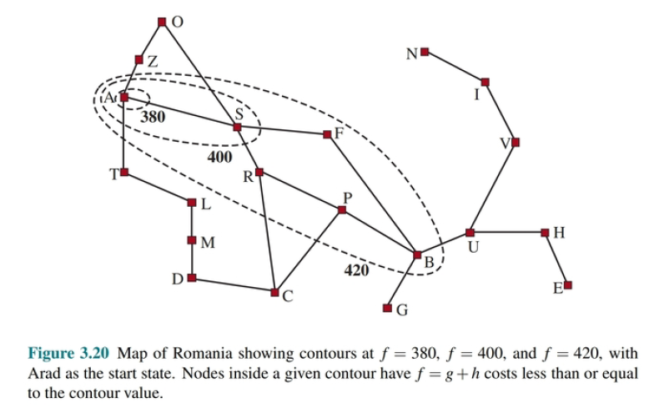
Search contours
A useful way to visualize a search is to draw contours in the state space, just like the contours in a topographic map.

Slide 14
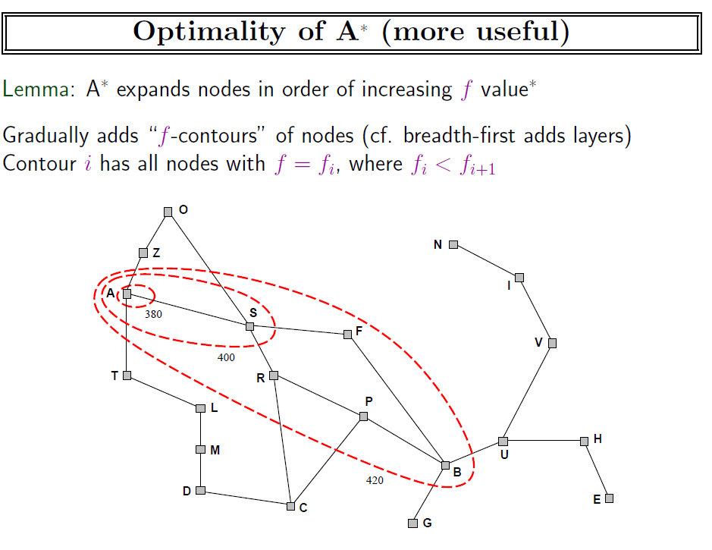

Slide 15
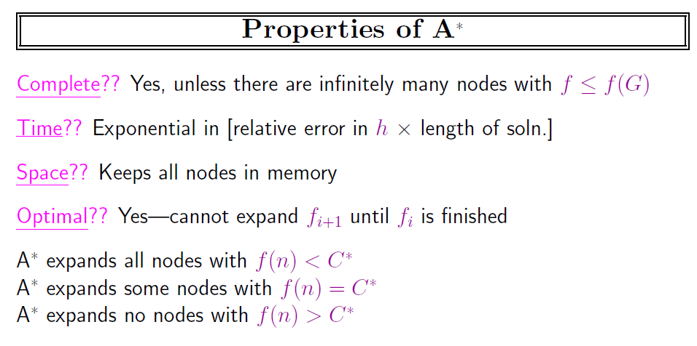

Slide 16
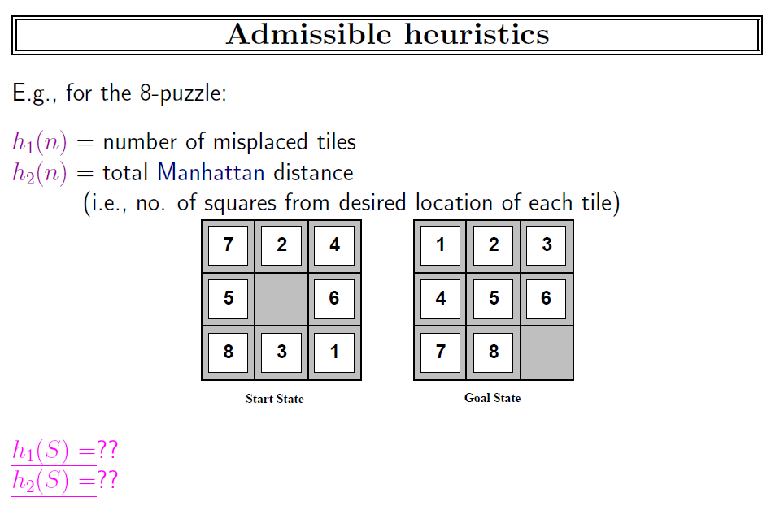

Slide 17
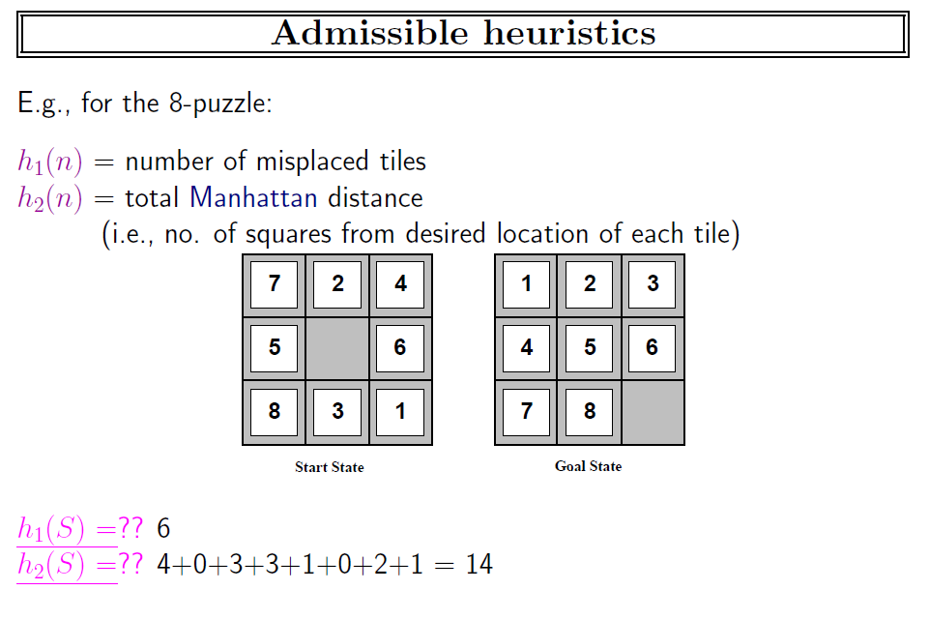

Slide 18
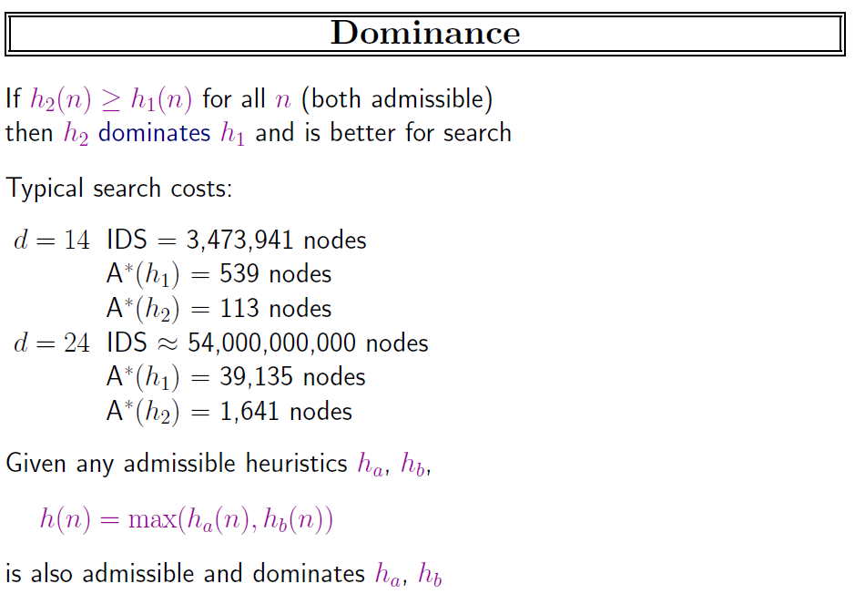

Slide 19
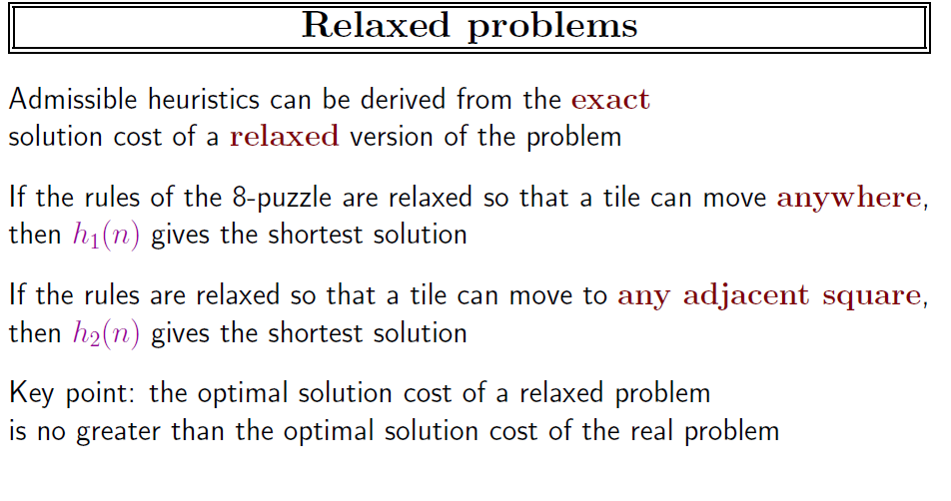

Slide 20
A problem with fewer restrictions on the actions is called a relaxed problem.
The state-space graph of the relaxed problem is a supergraph of the original state space because the removal of restrictions creates added edges in the graph.
Hence, the cost of an optimal solution to a relaxed problem is an admissible heuristic for the original problem.

Slide 21
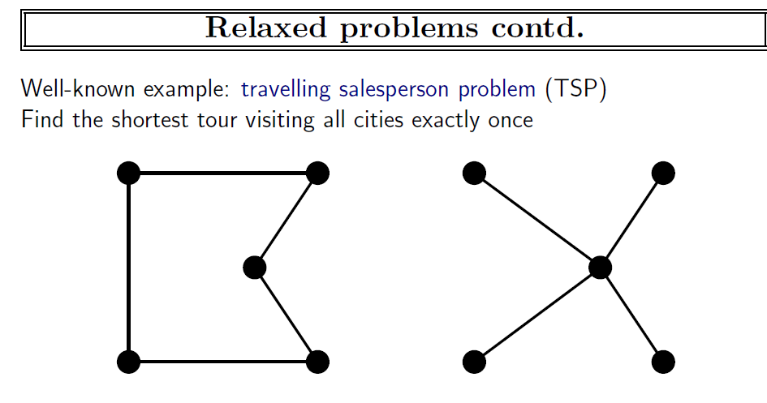

Slide 22
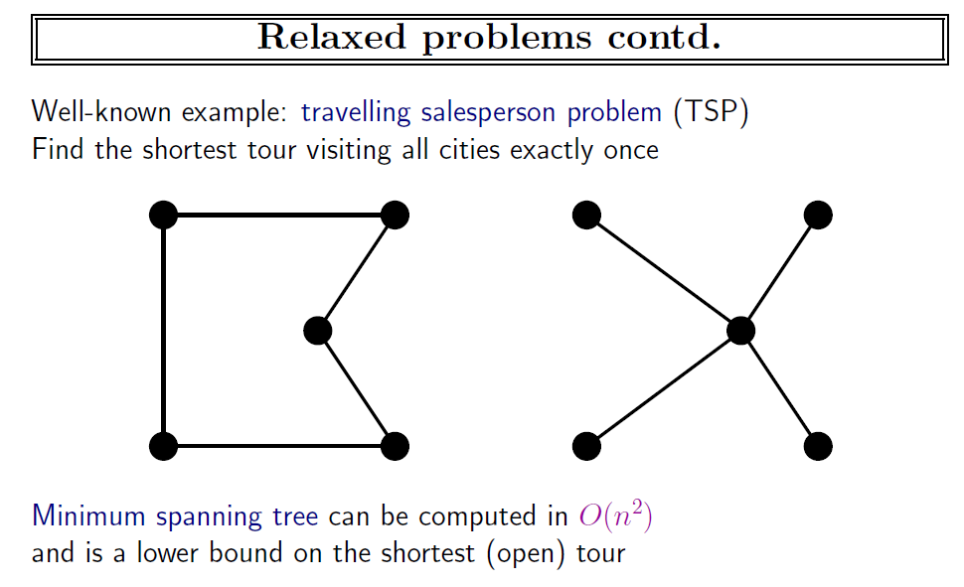

Slide 23
